Slide 1
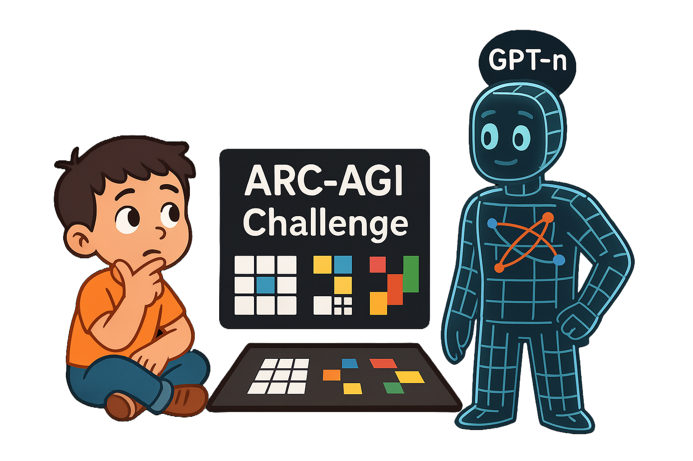

Bridging Human Intuition and AI: Why ARC Matters
Abdurrezak Efe
Diva Conference 2025
July 25th, 2025

Slide 2
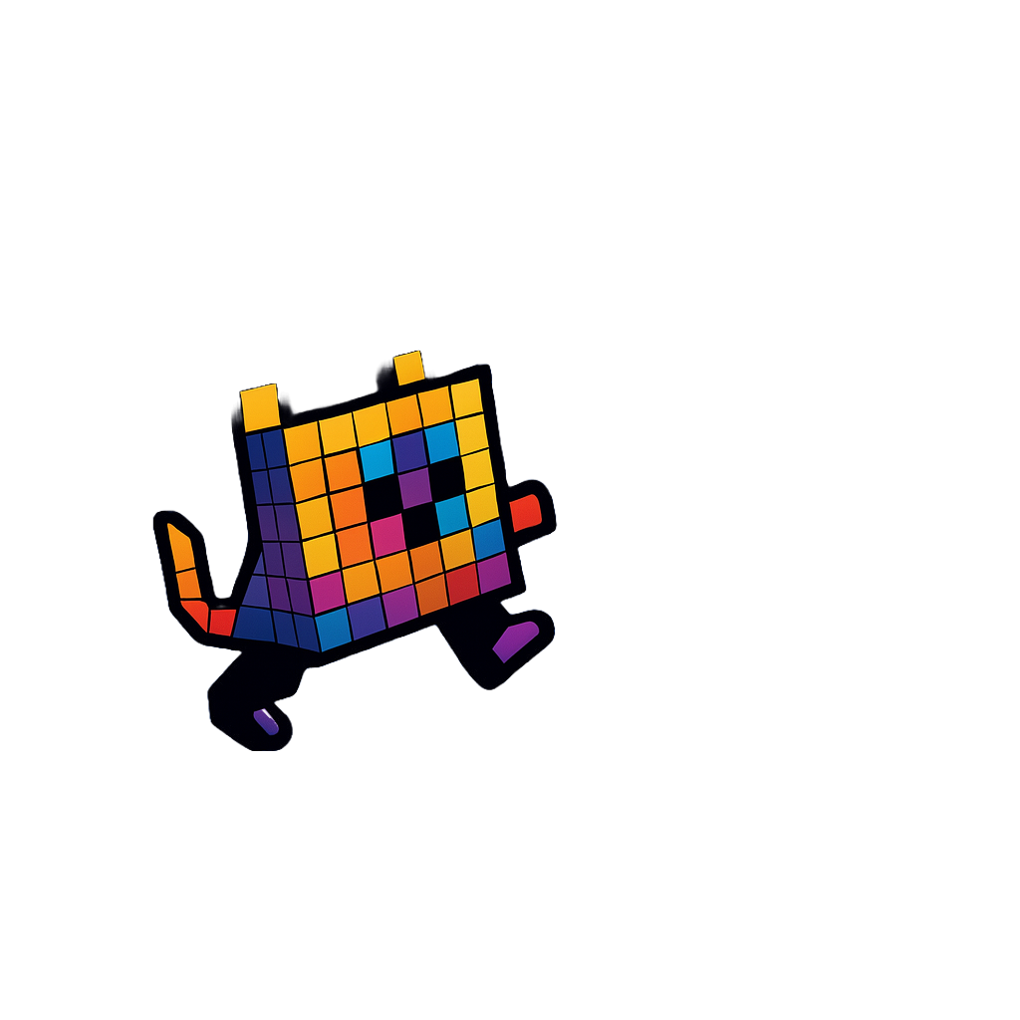
Outline
On the Measure of Intelligence
ARC-AGI-1
Methods used
Lessons learned
ARC-AGI-2
What have ARC-AGI given us?
What does the future hold?

Slide 3

On the Measure of Intelligence
What is intelligence?
Intelligence is the efficiency with which an agent turns its experience and priors into skill at previously unknown tasks, across a wide scope of possible tasks and situations. [1] -François Chollet

Slide 4
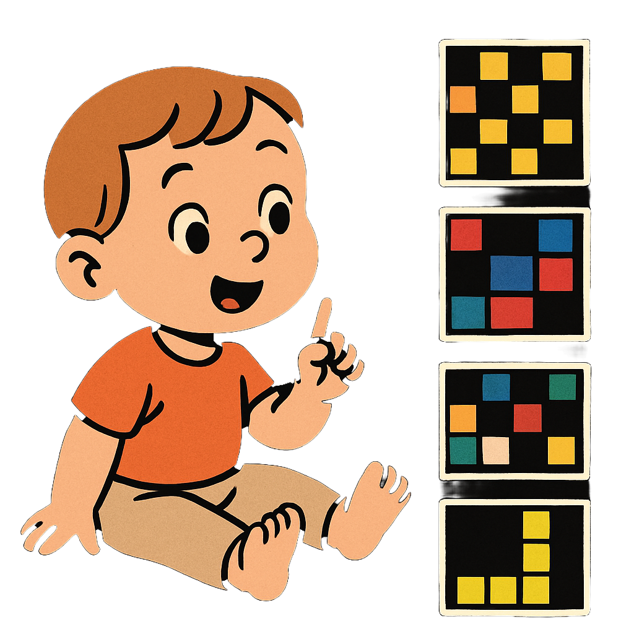
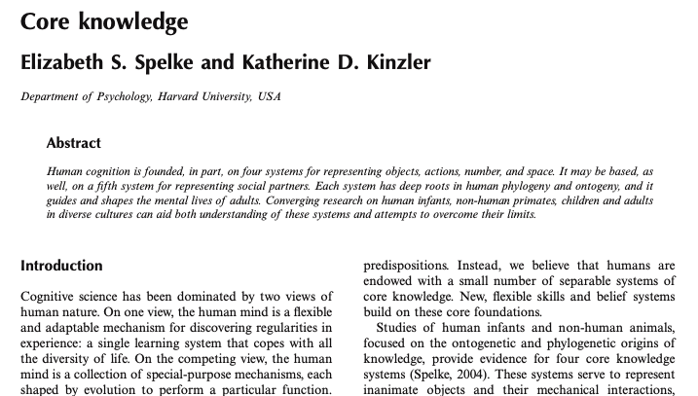
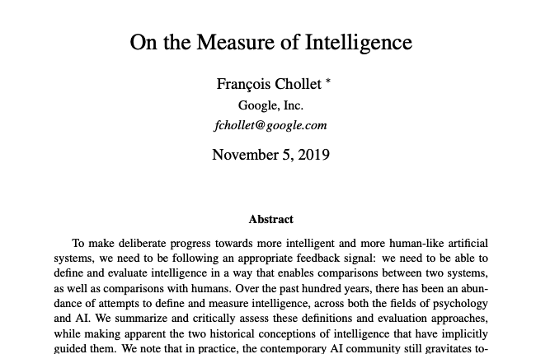
Core Knowledge Theory
Spelke [2] says:
Objectness
Numbers, quantity
Spatial navigation system
Social agent system
Domain-specific learning constraints

Slide 5
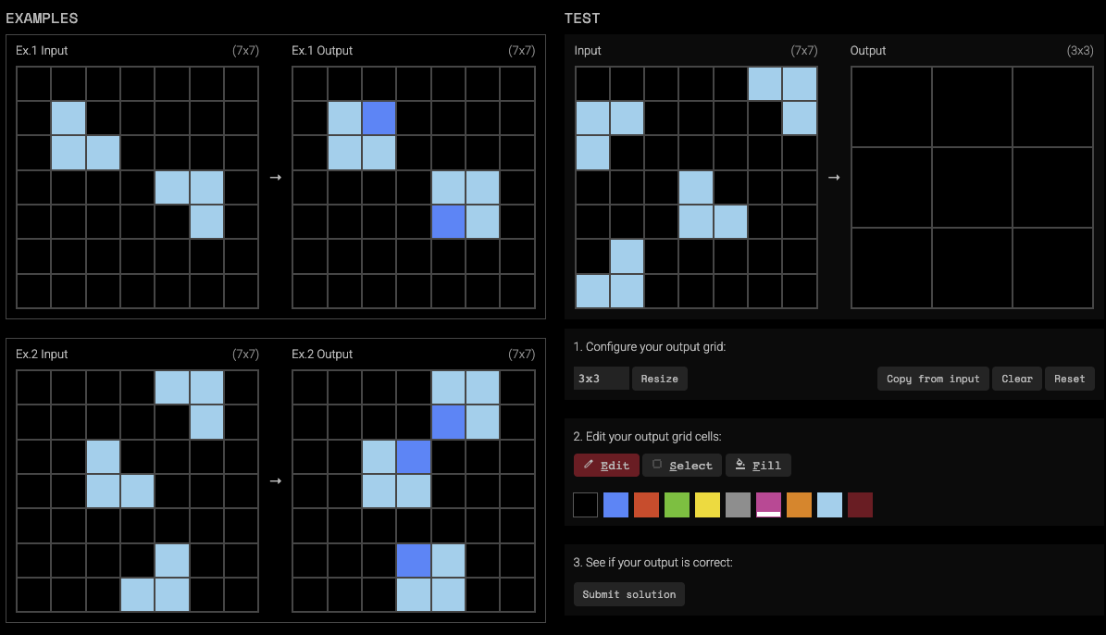
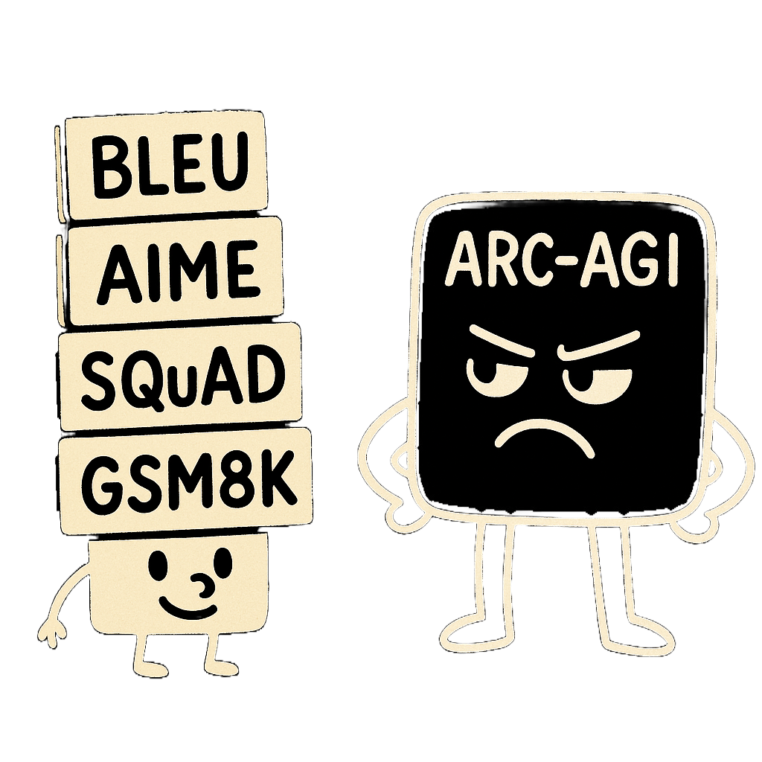
2. ARC-AGI-1
Abstraction and Reasoning Corpus
First benchmark for reasoning while easy for humans

Slide 6
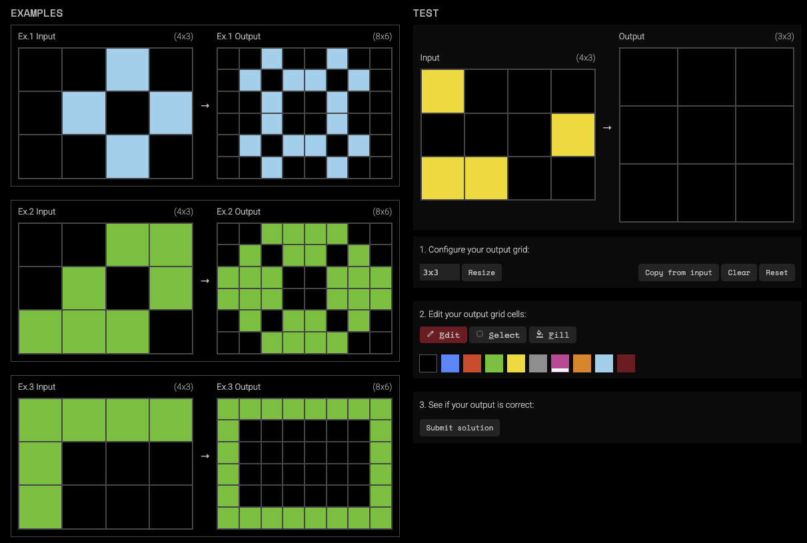

Slide 7
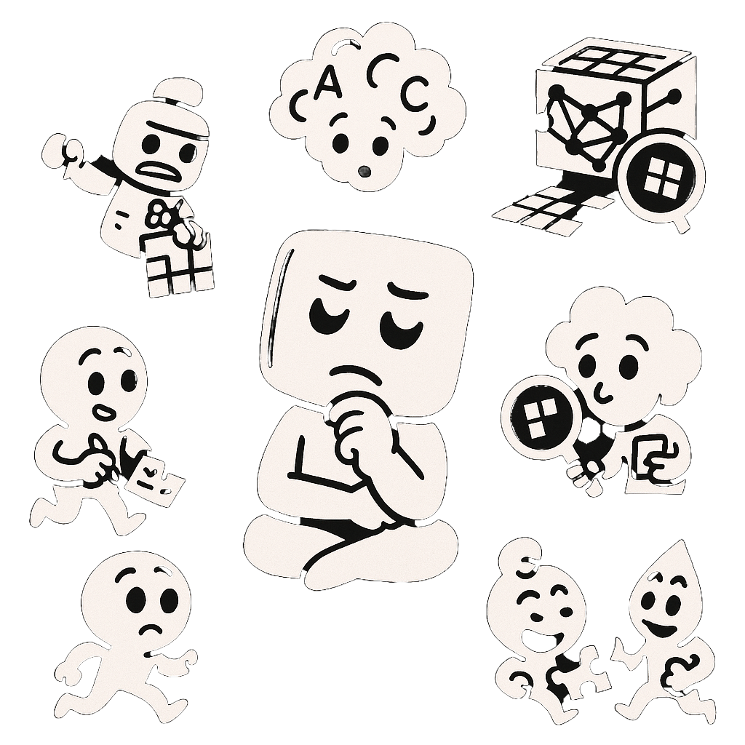
How did the contestants tackle it?
Brute force program search on custom DSL [3]
LLMs
Test-time Training (TTT) [4]
LLM guided program search [5]
Deep Learning guided program search [5]
Hybrid methods [6]

Slide 8
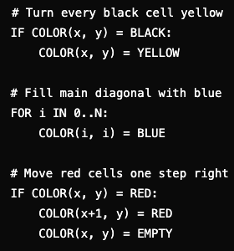
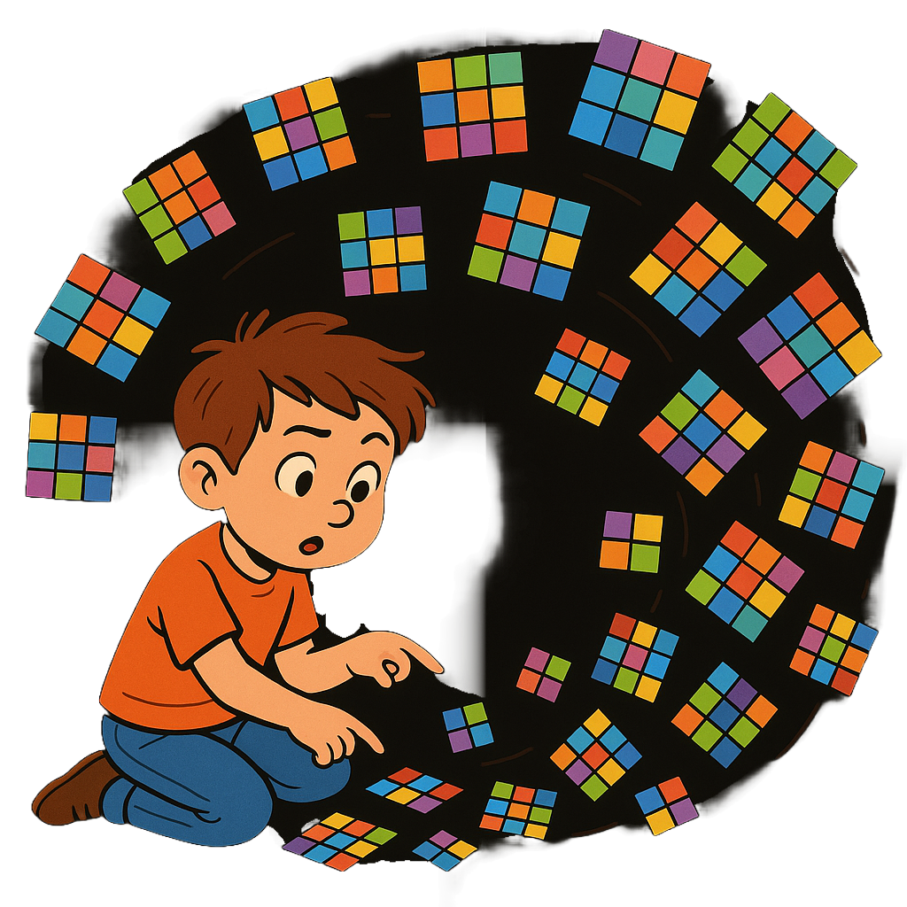
Brute force program search via Domain Specific Language
Search space is too large
Discrete and combinatorial

Slide 9
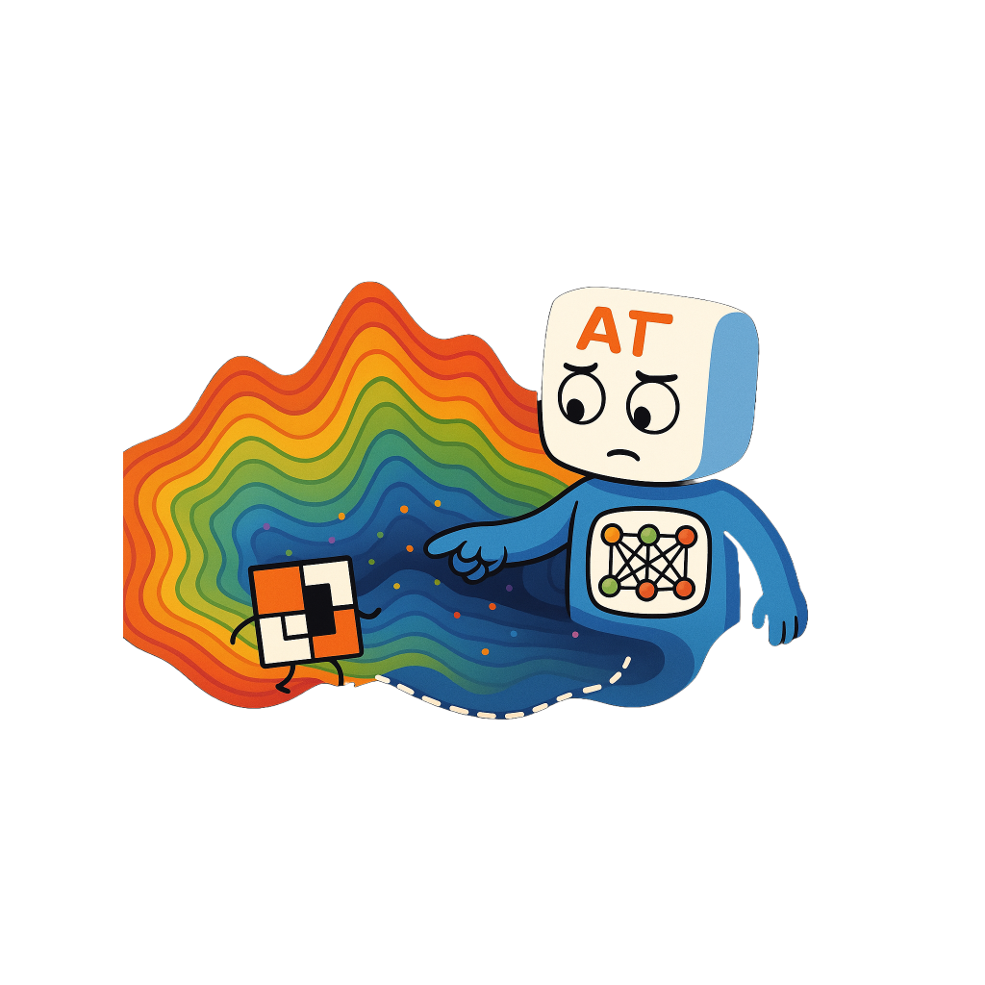
Deep learning guided program search
Cheaper compared to brute force
Can be done on latent program space
LLM variant became successful

Slide 10

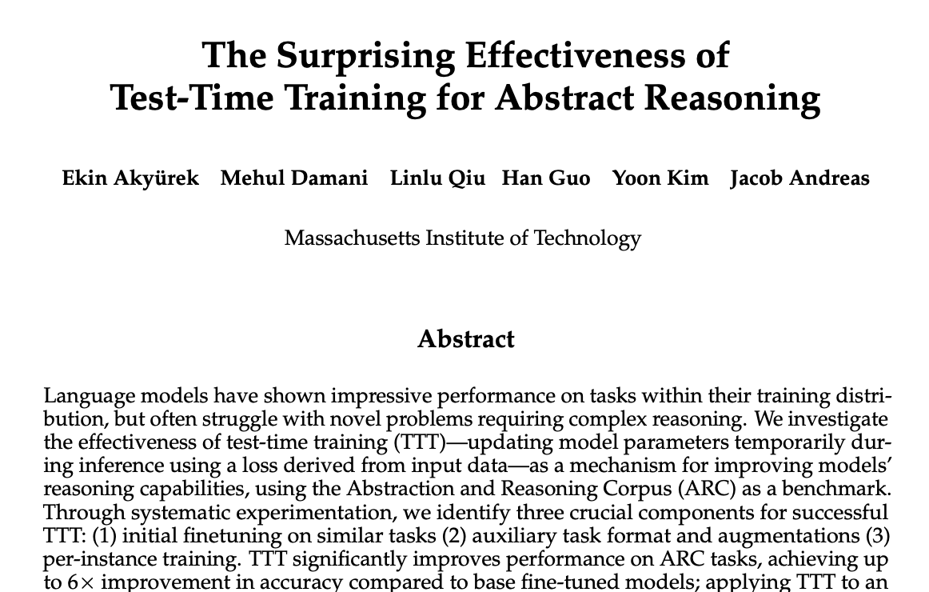
Test-Time Training
The MVP of ARC-AGI-1
Allows adaptation per task
[4]

Slide 11

Test-Time Training + LLM guided program synthesis
Best results over ~55.5%
The ARChitects (1st place, 53.5% private score): Their method included TTT on a specialized transformer (NeMo-Minitron-8B) with data augmentation and a solution stability criterion, and they combined this with program synthesis.
OmniARC (Guillermo Barbadillo): Used a Qwen2.5-0.5B-Instruct model with TTT and a program synthesis ensemble.
Akyürek et al.: Used TTT on an 8B parameter model and combined it with program search.
[3]

Slide 12
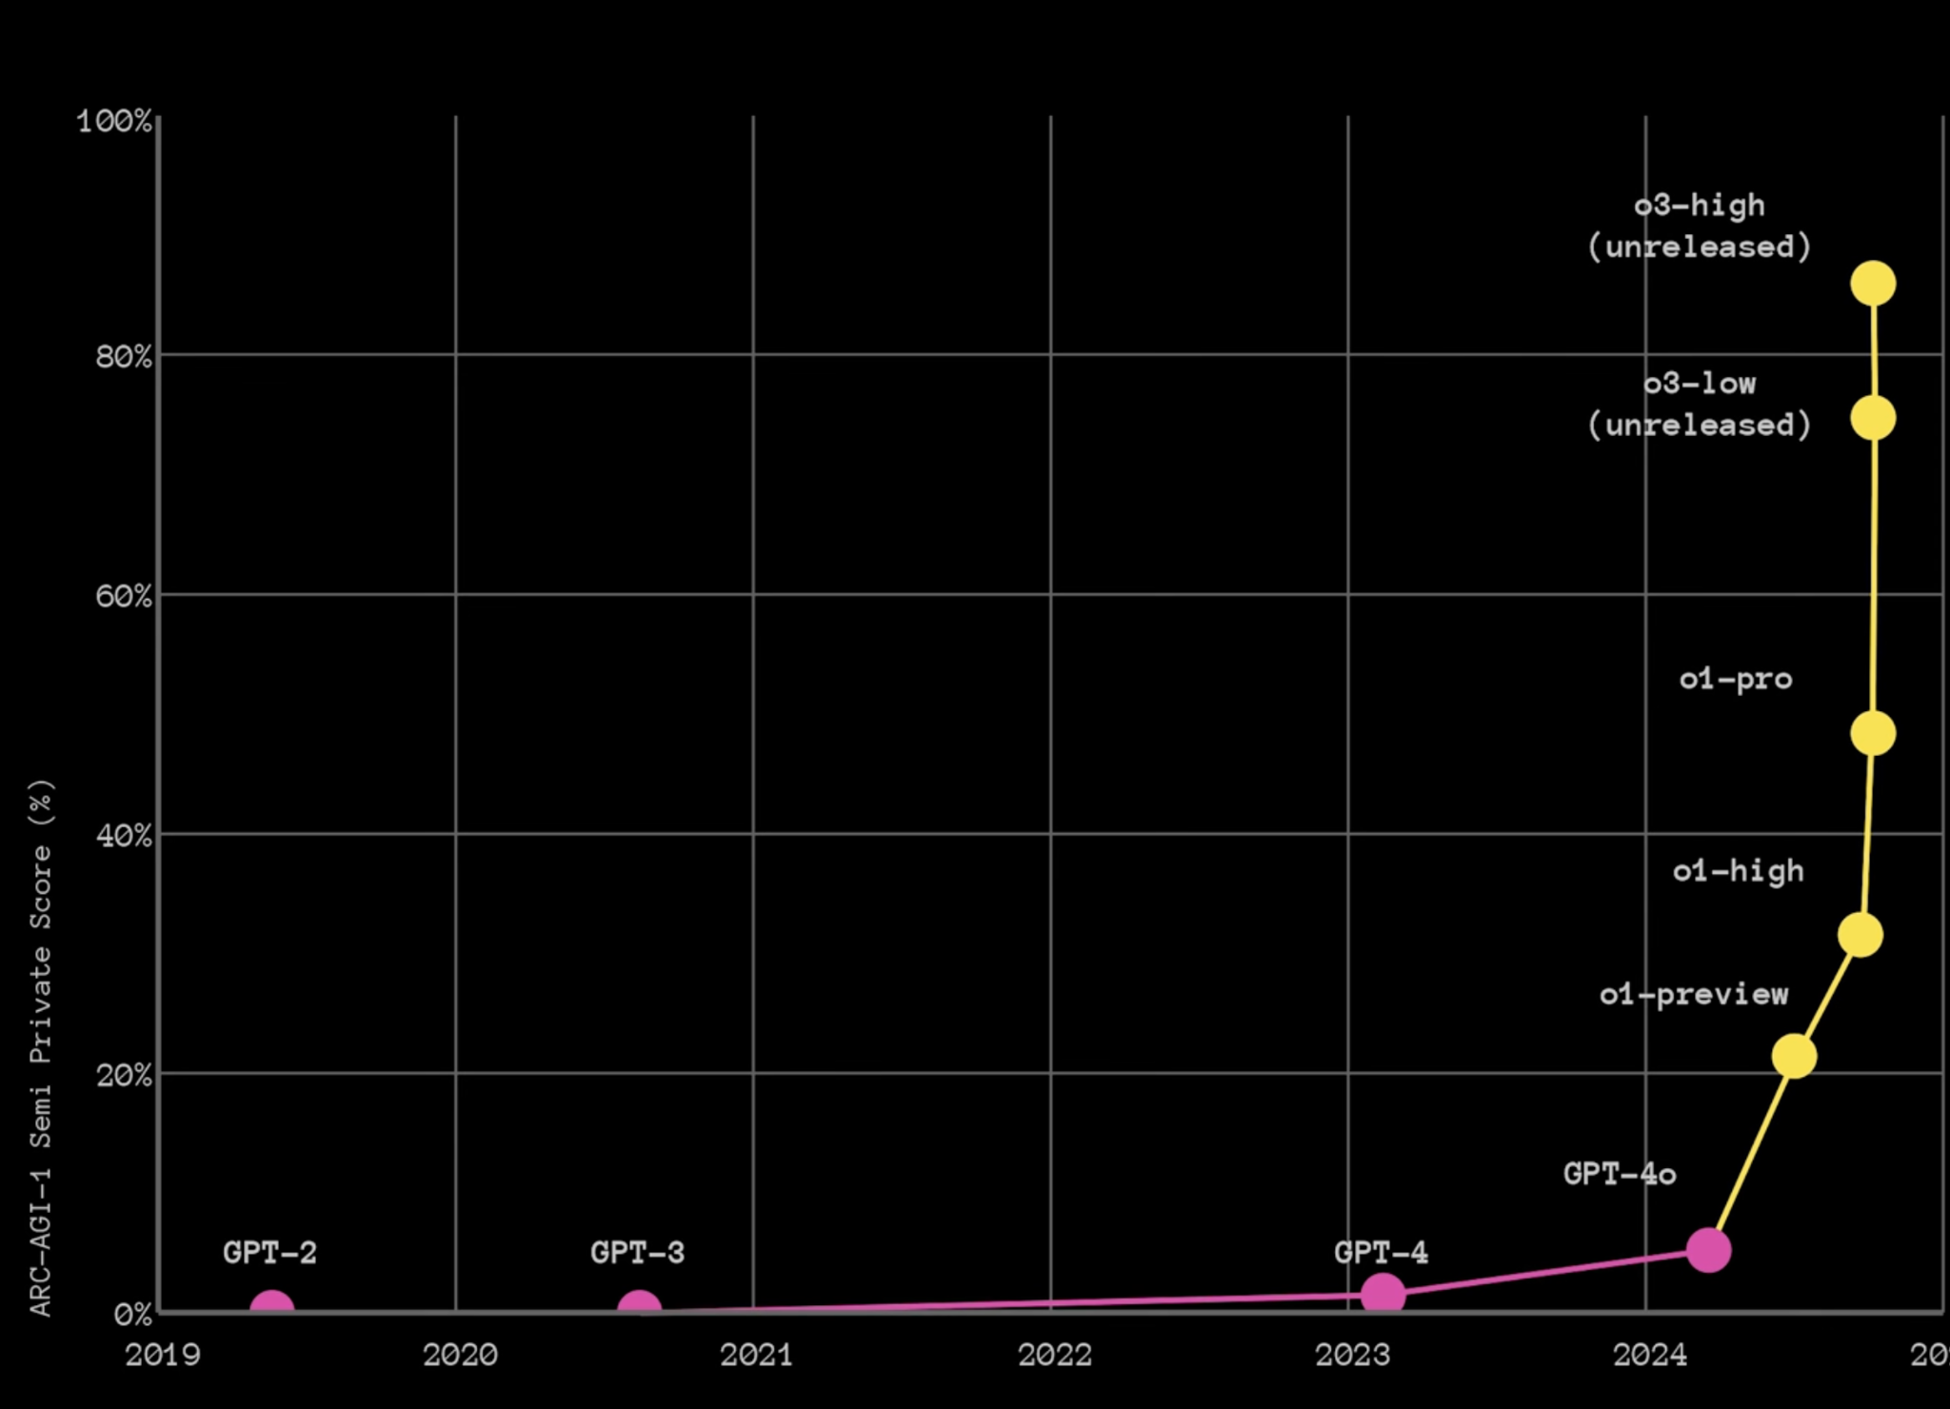
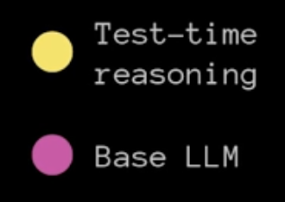
ARC-AGI-1 results
o3 was a breakthrough on ARC-AGI-1 [3]

Slide 13
Lessons learned
Pretraining with large corpora does not mean “reasoning”
Adaptation for each task is the key
ARC-AGI-1 is not a good signal for reasoning
Kaggle ensemble solved ~49%
ARC-AGI-1 is became saturated by the end of 2024
[3]

Slide 14
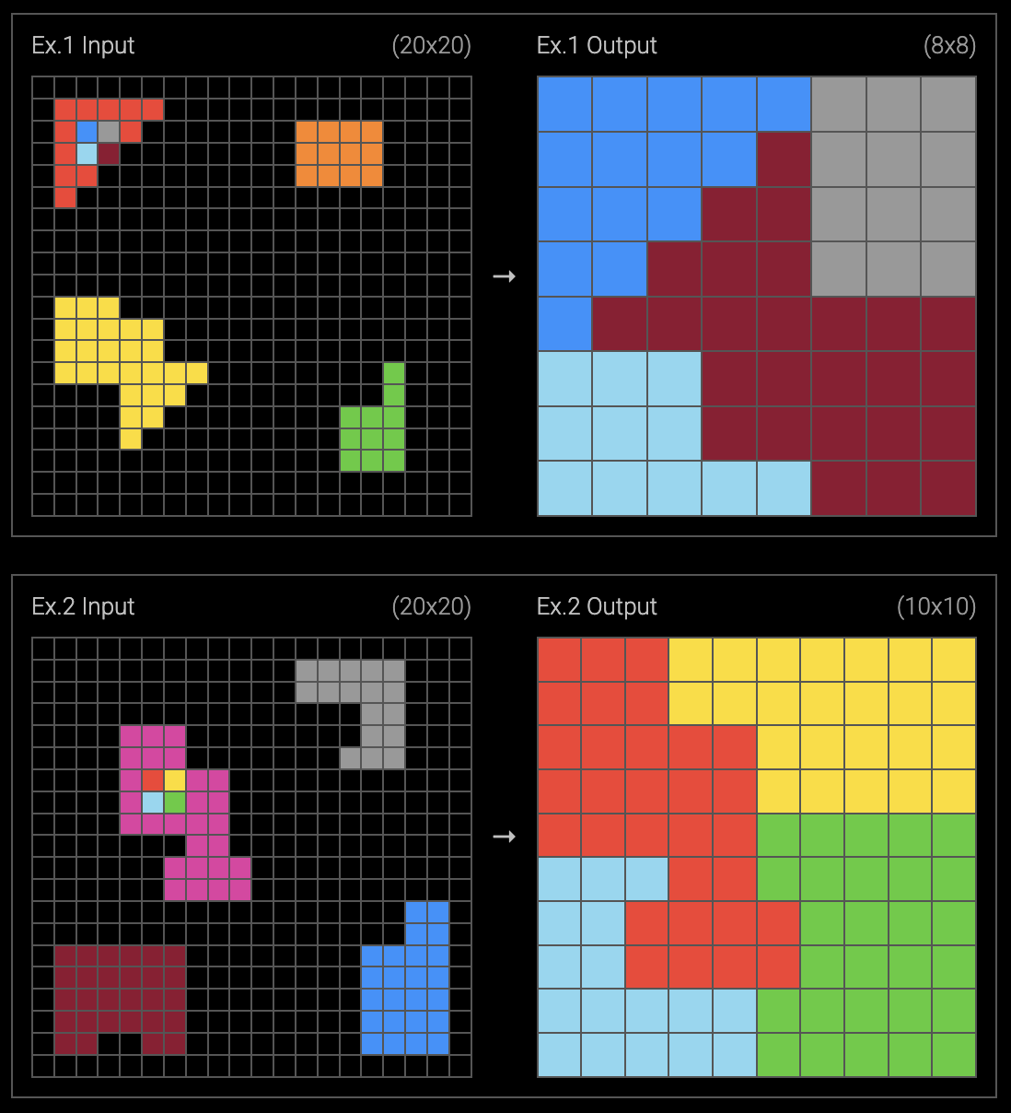
3. ARC-AGI-2
Color schemes are not constant
More steps needed on average
Distant cues must be considered
Human calibrated with 400 participants
Brute force DSL will be astronomically harder

Slide 15
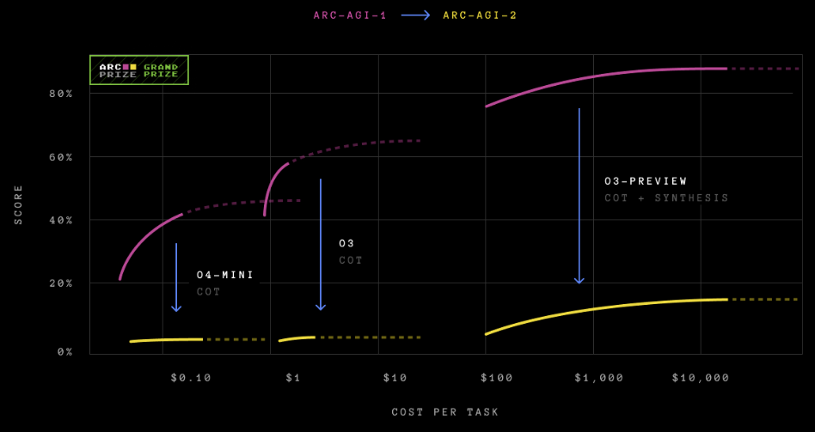
o3 vs ARC-AGI-2
o3-low scored 3% o3-high ~15%

Slide 16

What have ARC-AGI given us?
Isolating a missing human capability
Memorization vs fluid intelligence
Human calibrated and unsaturated
Efficiency matters as much as solution
Directs research into new horizons
Good early signal of o3

Slide 17

References
[1] F. Chollet, “On the Measure of Intelligence,” arXiv preprint arXiv:1911.01547, 2019.
[2] E. S. Spelke and K. D. Kinzler, “Core Knowledge,” Developmental Science, vol. 10, no. 1, pp. 89–96, 2007.
[3] ARC Prize, “ARC Prize Tech Report 2024,” 2024. [Online]. Available: https://arcprize.org/
[4] Y. W. Teh, J. Kirsch, et al., “The Surprising Effectiveness of Test-Time Training,” arXiv preprint arXiv:2006.01183, 2020.
[5] B. Bonnet and R. Macfarlane, “Searching Latent Program Spaces,” arXiv preprint arXiv:2210.13366, 2022.
[6] X. Li, J. Wu, et al., “Combining Induction and Transduction for Abstract Reasoning,” arXiv preprint arXiv:2307.09244, 2023.

Slide 18
Thank you! Q&A

